Slide 1
Lizards of South America

Slide 2
Lizards of South America: Biodiversity and Ecological Significance
South America is home to a diverse array of lizard species, each playing a vital role in the continent's ecosystems. This research delves into the fascinating world of South American lizards, exploring their unique characteristics, habitats, and ecological significance. The study also highlights the threats these lizards face and examines the conservation efforts in place to protect them.

Slide 3
South South South South South South South
South America is home to a remarkable diversity of lizard species, with over 200 species found in the continent. This diversity is due to the unique geographical features and climate conditions of South America, which have created a variety of habitats that support different types of lizards. Some of the most notable lizard families in South America include the geckos, anoles, leiosaurids, polychrotids, and the green iguana.

Slide 4
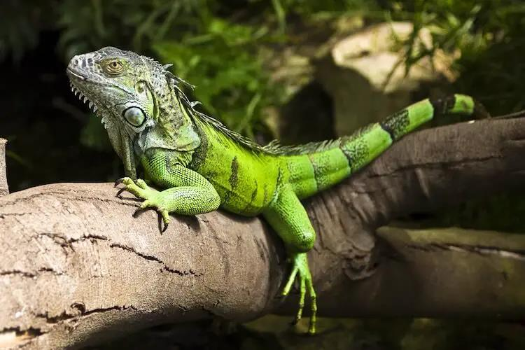

Slide 5
and and and and and and and
The Caiman Lizard is a semiaquatic species native to South America. It is characterized by its serrated tail and plays a vital role in controlling aquatic vegetation. The Tepui Lizard is a unique reptile inhabiting highland plateaus in South America. It has developed remarkable adaptations to its environment and remains relatively understudied.

Slide 6
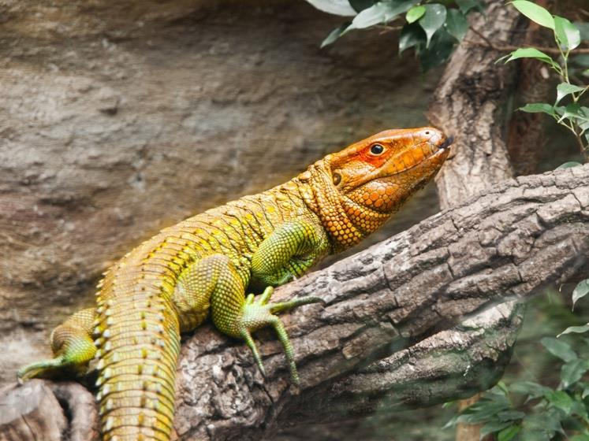

Slide 7
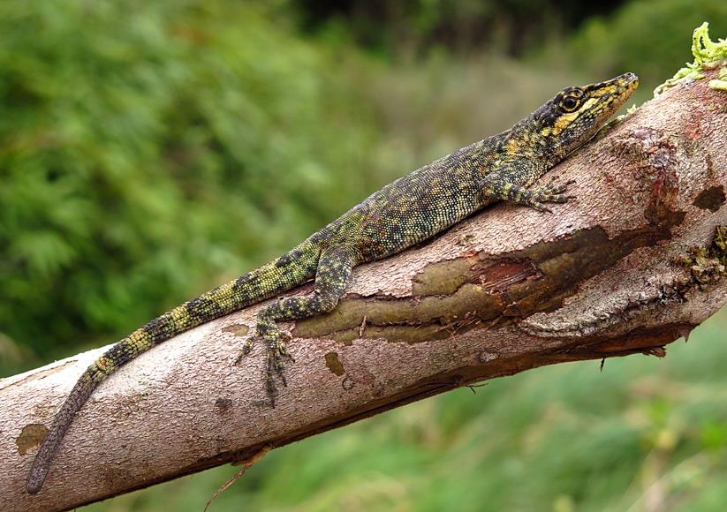

Slide 8
South American Lizards: Biodiversity and Conservation
South American lizards, including the Green Iguana, Caiman Lizard, and Tepui Lizard, are fascinating creatures that inhabit diverse habitats across the continent. These lizards face threats such as habitat loss, illegal pet trade, pollution, and climate change, which require conservation efforts to safeguard their survival. They play crucial ecological roles in their respective habitats, contributing to insect control, seed dispersal, and the food chain. By learning about these unique reptiles, we can appreciate their beauty and the vital role they play in maintaining the balance and health of South American ecosystems.

Slide 9
South American Lizards: A Treasure Worth Preserving
South American lizards face numerous threats, including habitat loss, climate change, and illegal trade. Urgent conservation efforts are necessary to protect their habitats and promote their welfare. Conservation initiatives and protected areas will ensure the preservation of their natural environments. By appreciating and conserving South American lizards, we preserve their diversity and uphold the integrity of their ecosystems.

